Slide 1
Selective Laser Sintering 3D Printer
ELEC 341 Design Project
Part 1
Muchen He 44638154
Leo Liu 18800152

Slide 2
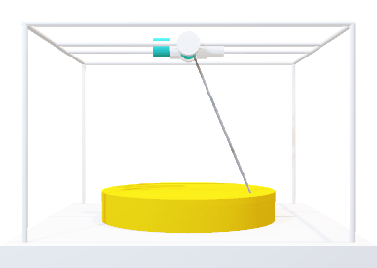
System Overview
Coordinates (X, Y, Z)
The 3D printer uses a laser to build parts. The laser is oriented using a two-axis motor assembly.
The inverse kinematic module converts the Cartesian coordinates to the desired motor angle.
Inverse Kinematic
The joint controller module handles the system response and controller.
The direct kinematic converts actual motor angles back to Cartesian coordinates
Joint Controller
The laser control module adjusts the intensity of the laser based on how far the target is
Direct Kinematic
The motors control the orientation of the laser
Laser Control
Motors

Slide 3
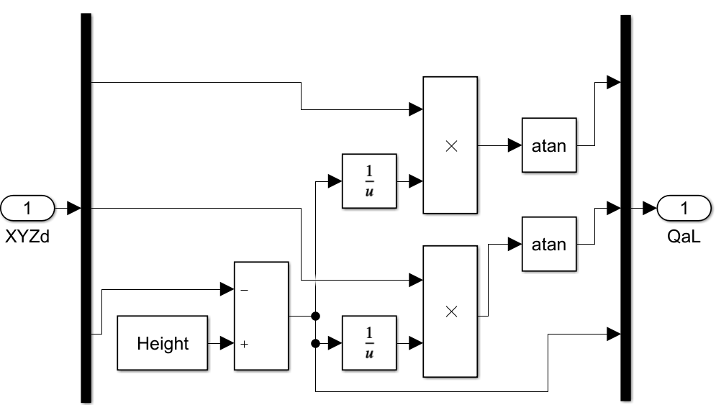
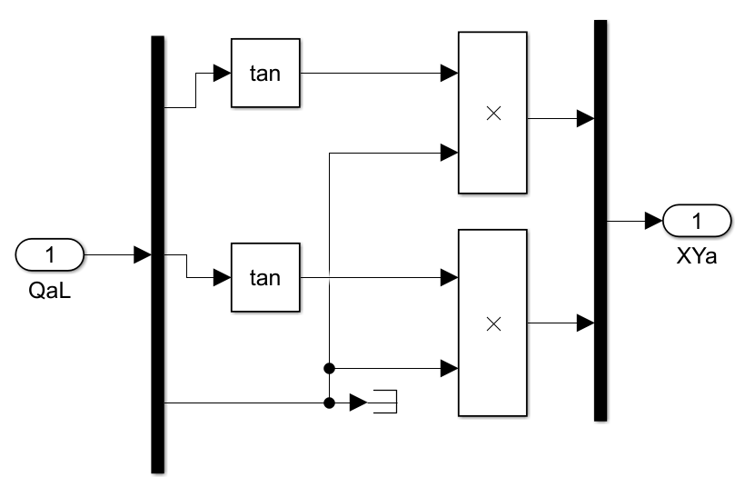
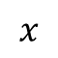


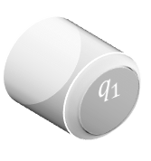



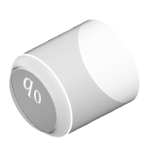



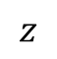


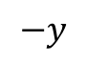

$$z$$
Inverse & Direct Kinematic
$$q_{1}$$
$$q_{0}$$
The inverse kinematic module converts the Cartesian coordinates to the desired motor angle.
$q_{0}$: angle of motor 0
$$q_{0}=\tan^{−1}{\frac{x}{z^{′}}}$$
$$q_{1}=\tan^{−1}{\frac{y}{z^{′}}}$$
$$z^{′}=\text{he}\text{ight}−z$$
$q_{1}$: angle of motor 1
$z′$: Distance between laser and top of part
Desired $x$
The direct kinematic converts actual motor angles back to Cartesian coordinates
Desired $y$
$$x=z′\tan\left(q_{0}\right)$$
Desired $z$
$$−y$$
$$y=z′\tan\left(q_{1}\right)$$
$$x$$
I.K. implementation in SimuLink
D.K. implementation in SimuLink

Slide 4
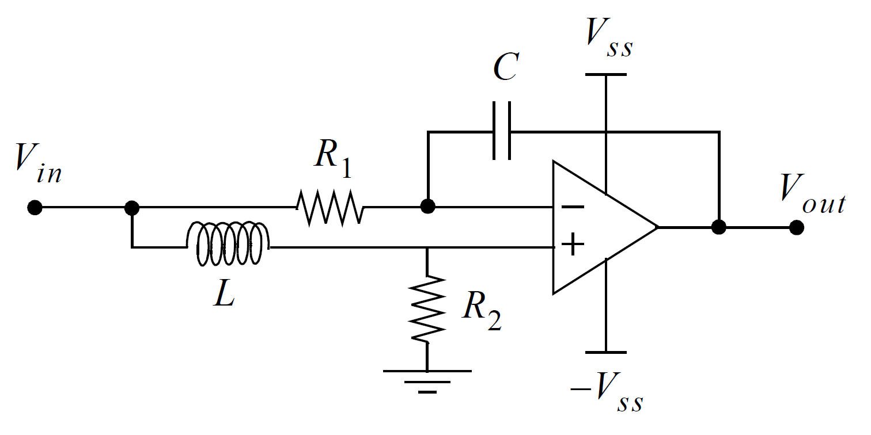
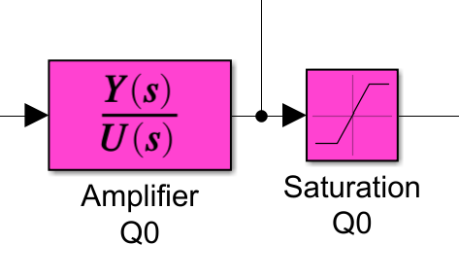
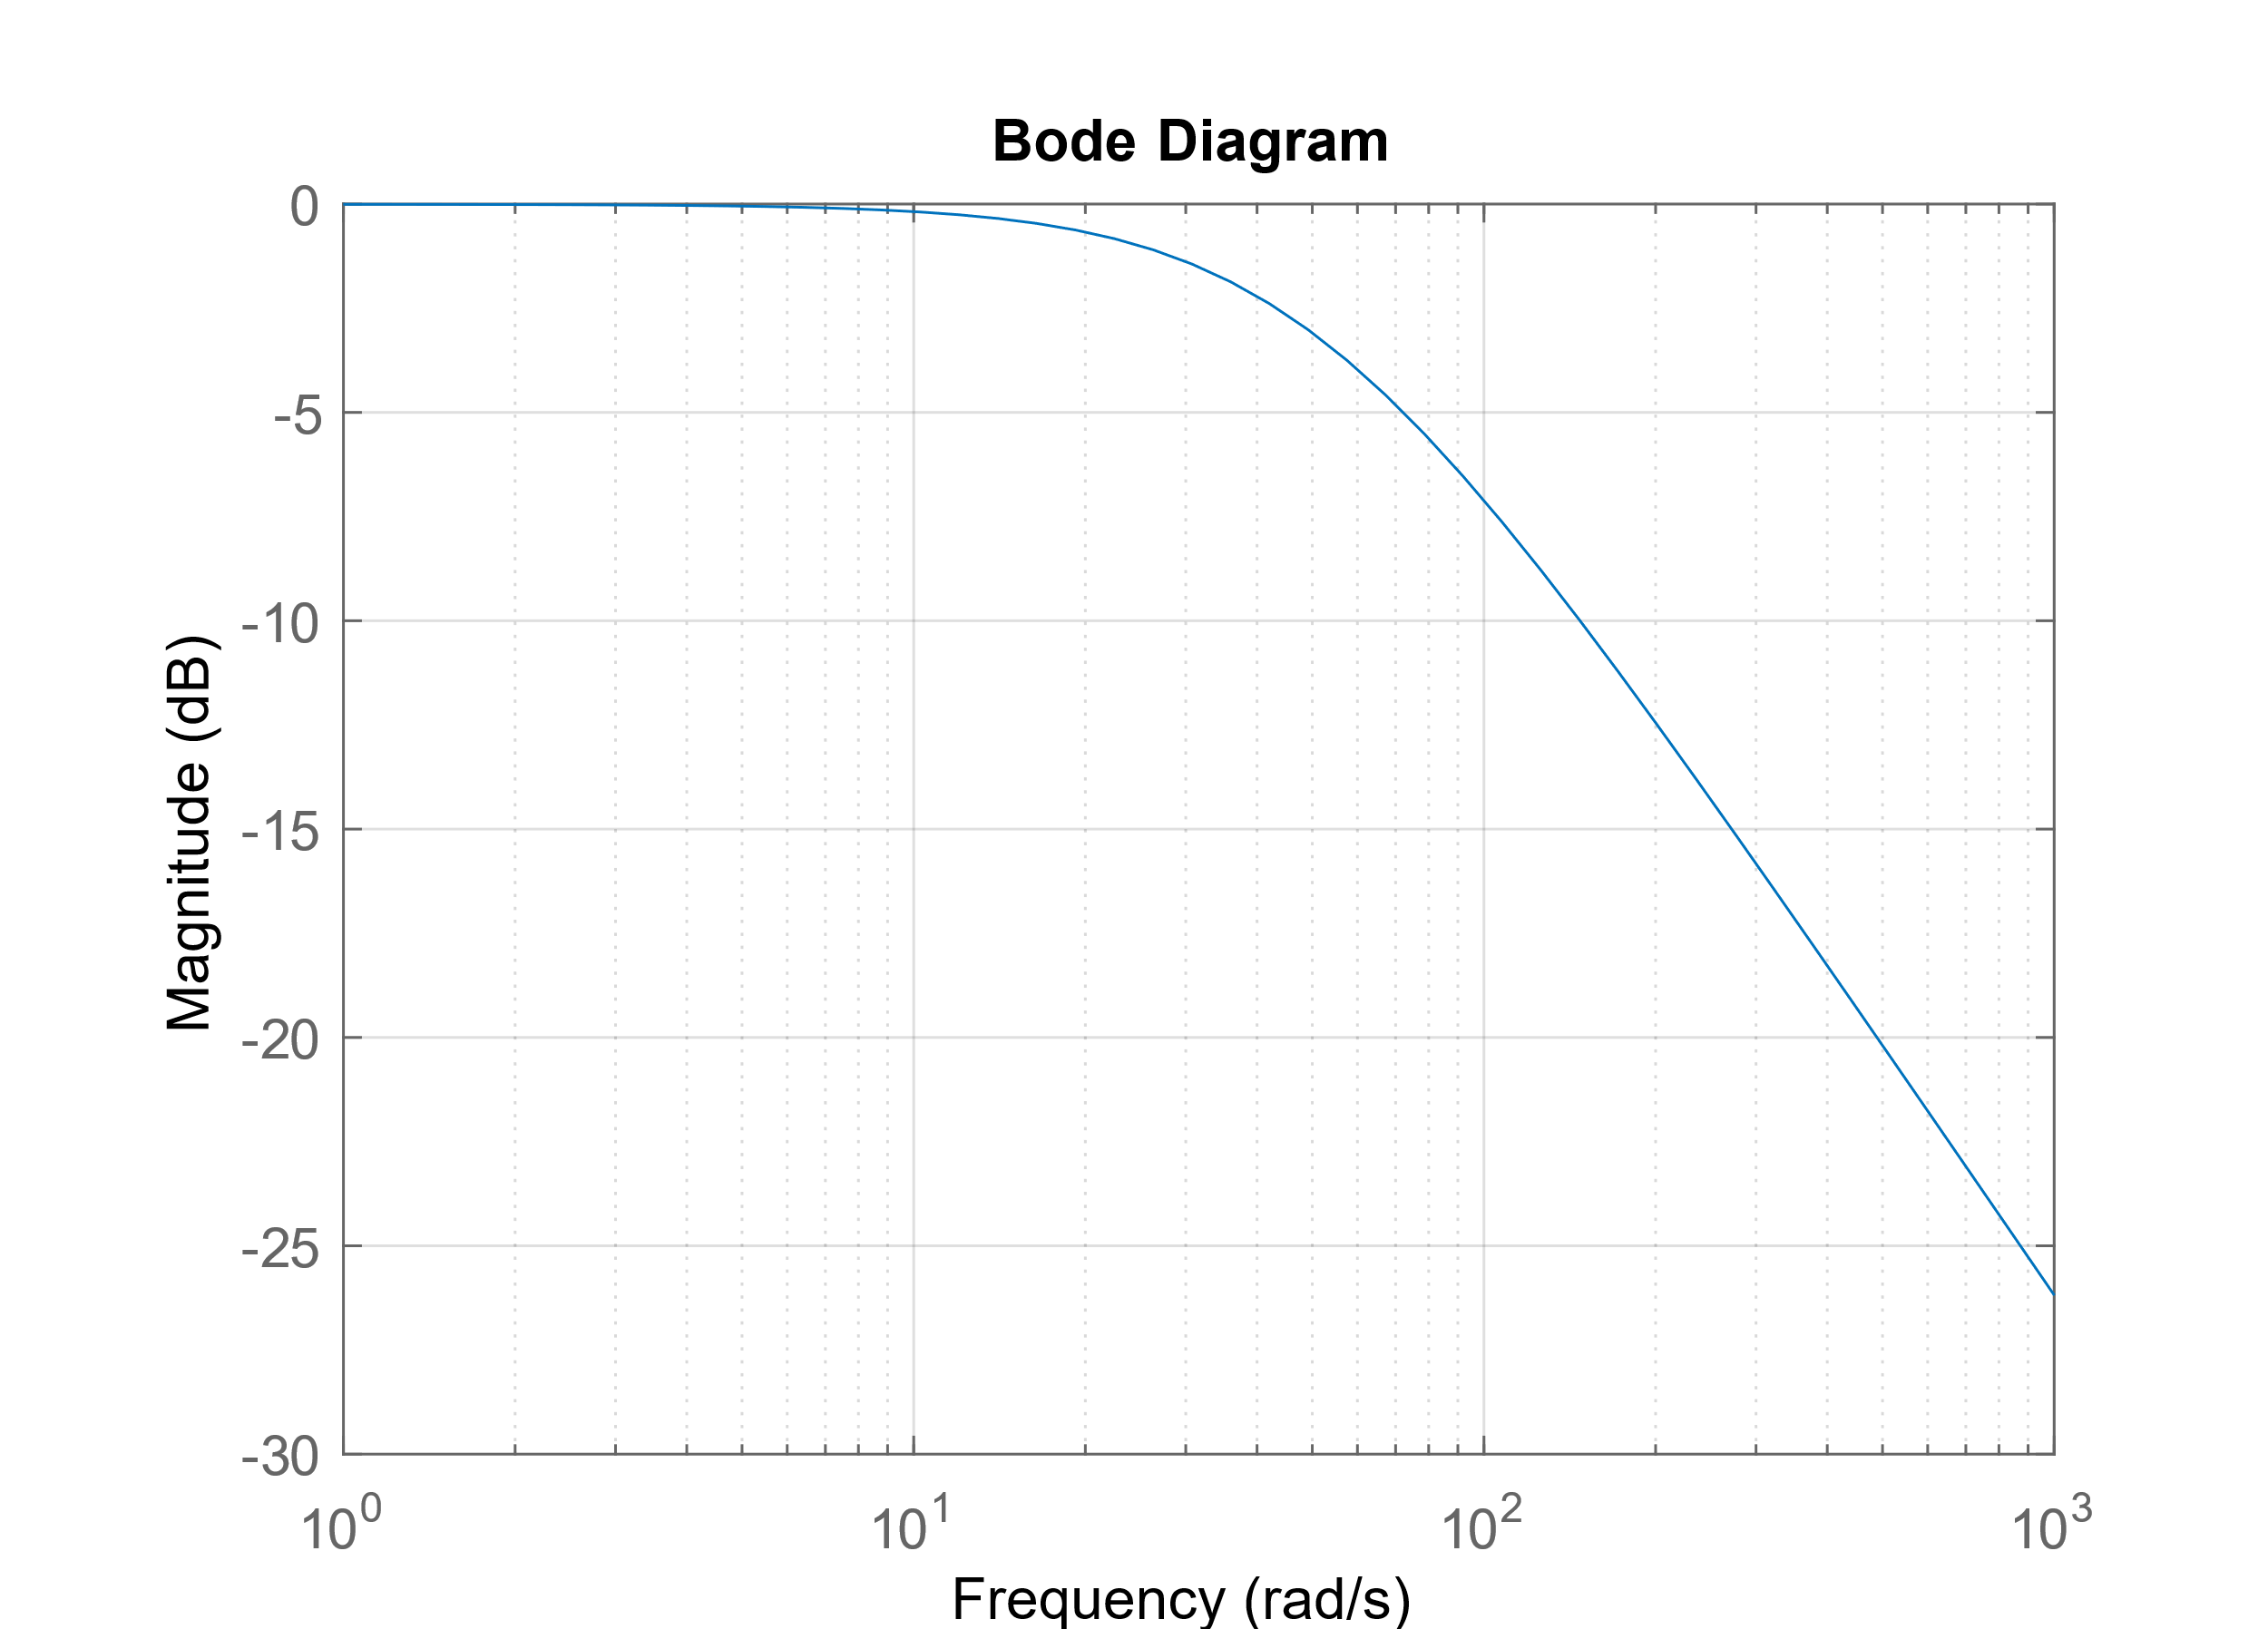
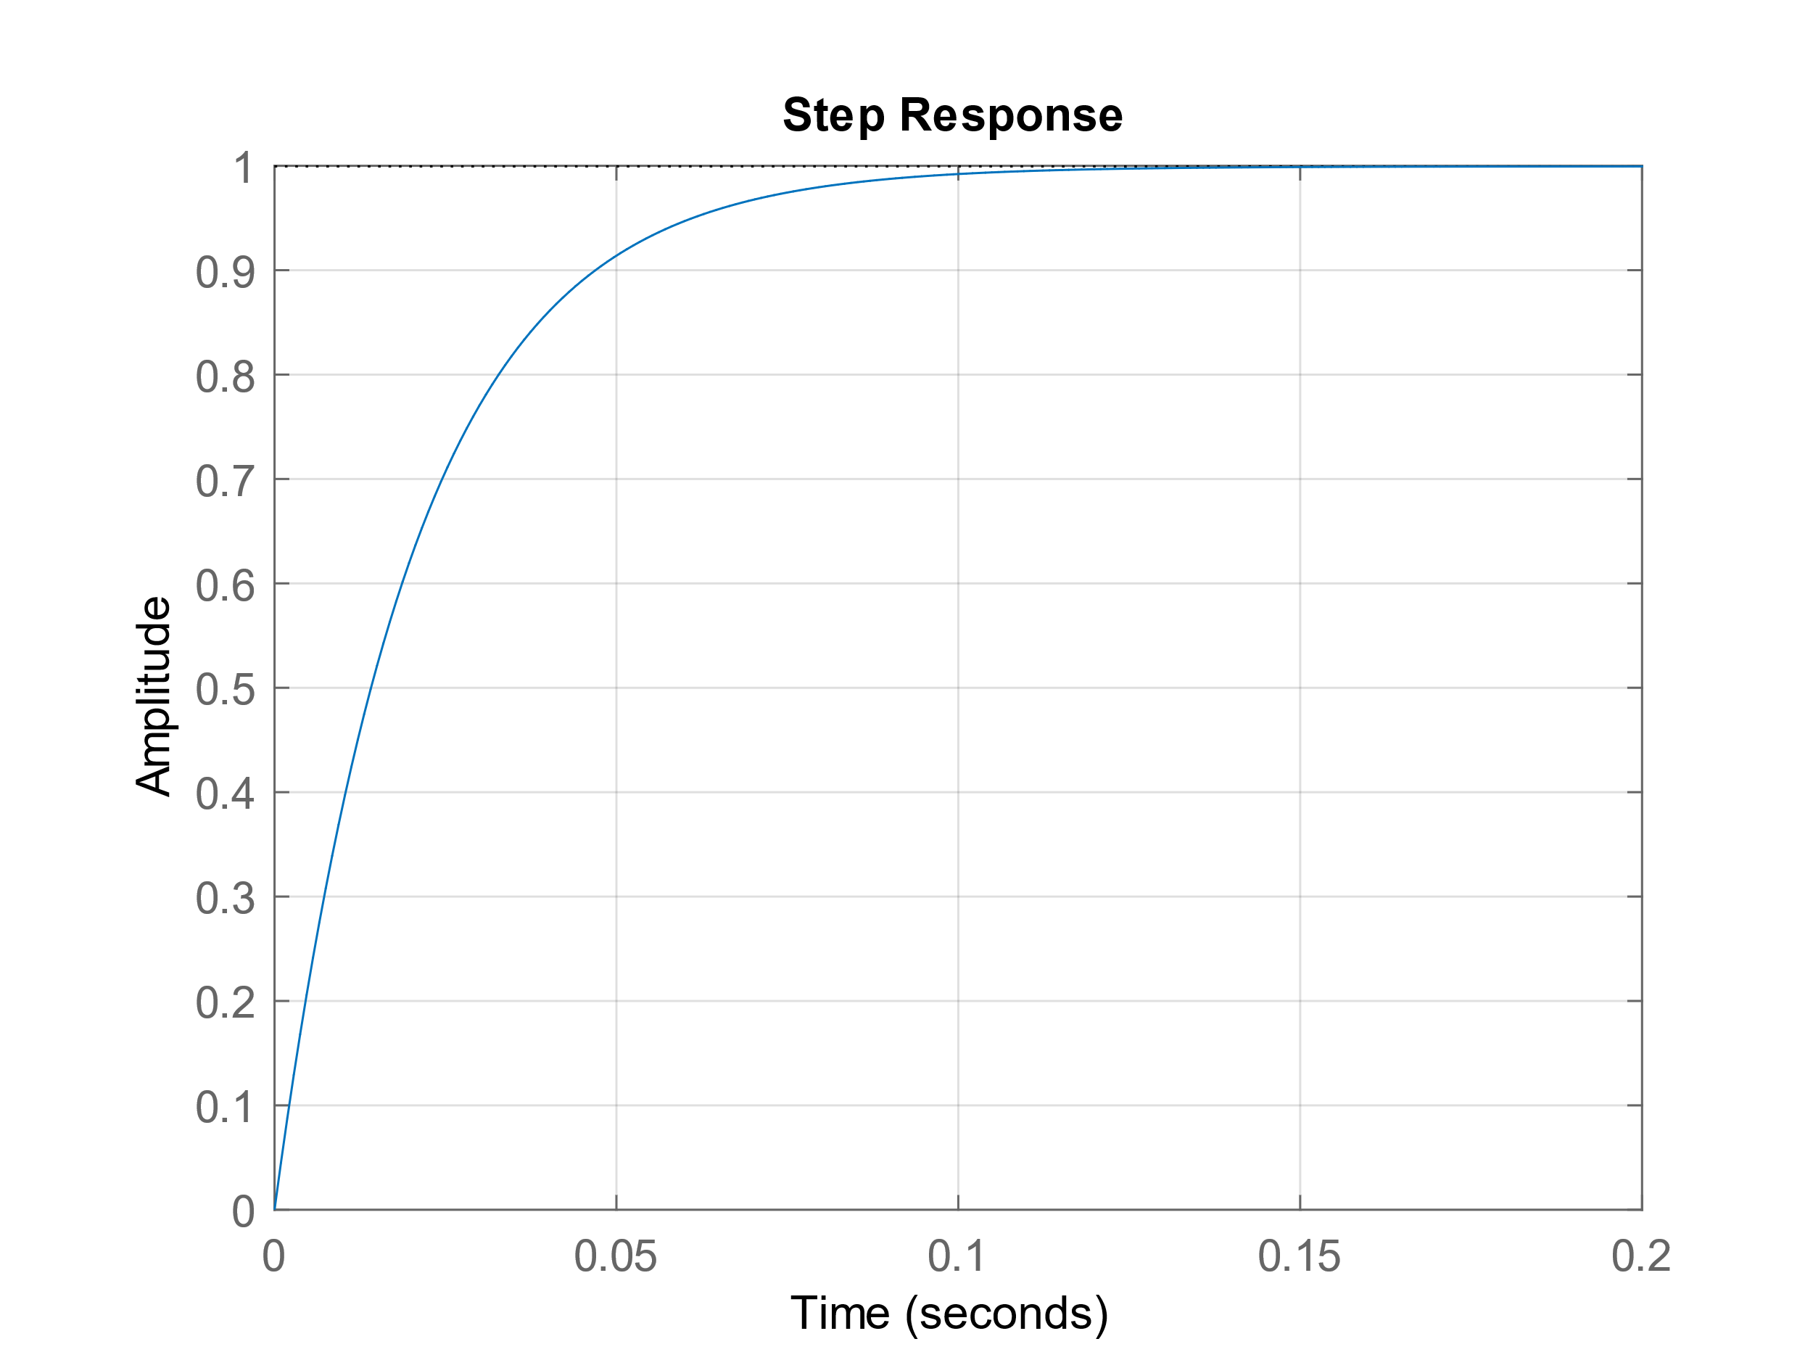





Power Amplifier
$$V_{n}$$
The power amplifier takes the role of a filter and a voltage follower.
The transfer function is the output divided by input.
Since there is negative feedback coupled by the capacitor, $V_{n}=V_{p}$.
MNA is used to solve the circuit
$$V_{p}$$
Amplifier circuit
SimuLink implementation
MNA:
$$\frac{V_{in}−V_{n}}{Ls}=\frac{V_{n}}{R_{2}}$$
$$\frac{V_{in}−V_{n}}{R_{1}}=\left(V_{n}−V_{out}\right)×sC$$
Transfer Function: $\frac{V_{out}}{V_{in}}$ $=\frac{CR_{2}R_{1}−L}{LCR_{1}s+CR_{1}R_{2}}$

Slide 5
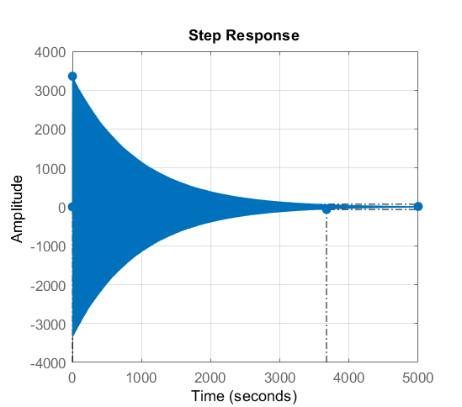

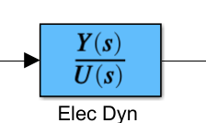

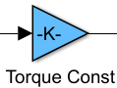













Electric Motor Dynamics
Response
The DC motor has relationships between the torque and the current
$$τ=K_{τ}i$$
The current is given by Ohm’s law
$$i=\frac{V_{in}−V_{emf}}{Ls+R}$$
The back-EMF is proportional to the motor speed
$$V_{emf}=K_{b}ω$$
The two motors for $q_{0} and q_{1}$ are identical, so the relationships are the same for both motors
Implementation
Motor 0
$$V_{i}$$
$$V_{o}$$
$$L$$
$$R$$
$$V_{in}$$
$$V_{emf}$$
Torque Gain
$$A$$
$$τ$$
Motor 1
Equivalent circuit

Slide 6
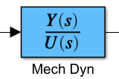

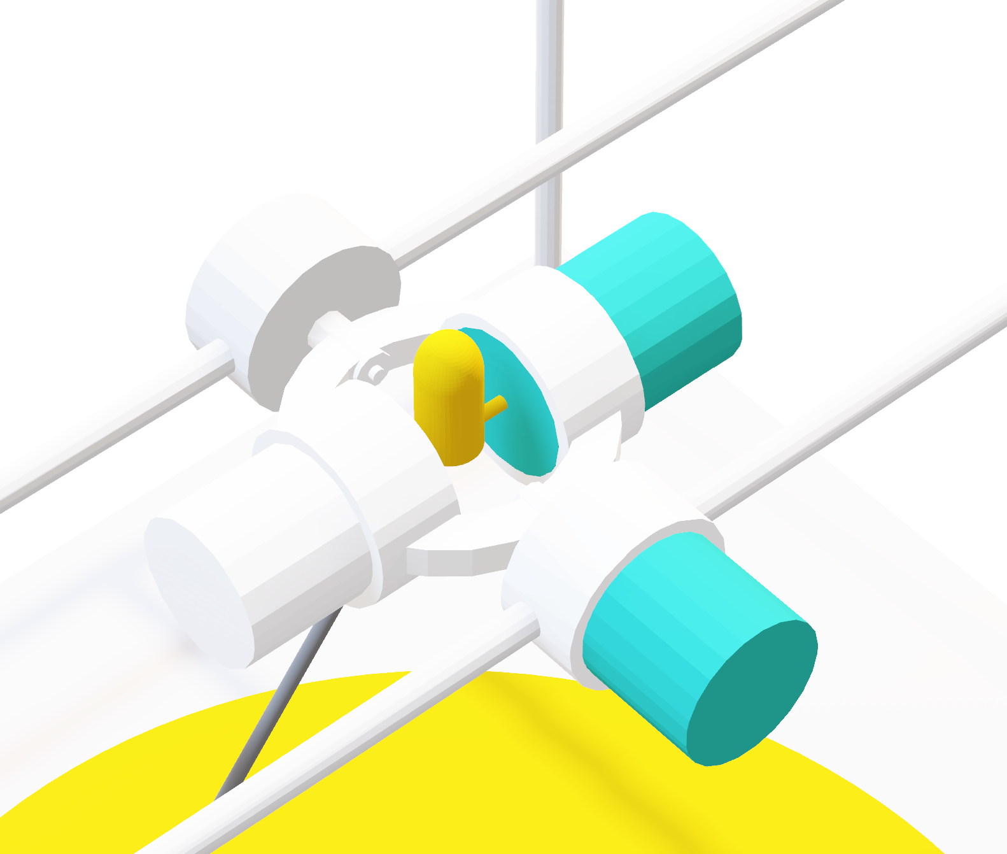





Mechanical Motor Dynamics
Mechanical motor dynamics is a transfer function to convert torque to angular speed. It is given as:
$$\frac{ω}{τ}=\frac{s}{Js^{2}+Bs+K}$$
Where $J$ is moment of inertia, $B$ is the kinetic friction constant, and $K$ is the spring constant.
Kinetic friction is the due to the mass imposed on the motion given as
$$B=\frac{I K_{τ}}{ω}$$
Spring constant is 0 for the inner motor, motor 1, and non-zero spring constant for the outer motor, motor 0.
Implementation
Moment of inertia for motor 1 is just $J_{\text{rotor}}$ since the mass of load is negligible
$$τ$$
$$ω$$

Slide 7



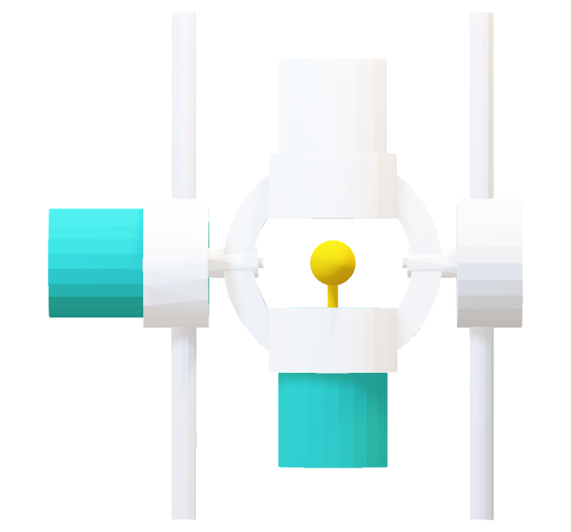
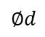




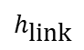

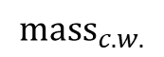



Mechanical Motor Dynamics
$${\text{mas}\text{s}}_{c.w.}$$
The moment of inertia component for the outer motor is contributed by the super position of four parts:
$$h_{\text{motor}}$$
$$r_{\text{out}}$$
$$l$$
$$r_{\text{in}}$$
Motor 0 rotor: Inertia due to the internal rotor of the outer motor
Aluminium link: Hollow cylinder, where mass is its volume multiplied by 6061 aluminium density
$$J_{\text{link}}=\frac{{\text{Mass}}_{\text{link}}}{12}\left(3\left({r_{2}}^{2}+{r_{1}}^{2}\right)+{h_{\text{l}\text{ink}}}^{2}\right)$$
$${\text{mas}\text{s}}_{q1}$$
Motor 1 & counter weight: $\text{mas}{\text{s}}_{c.w.}=\text{mas}{\text{s}}_{q1}$
$$h_{\text{link}}$$
$J_{q0}=$ $J_{link}+J_{rotor}+(J_{q1 weight}+J_{counter weight})$
$J_{q1}=$ $J_{rotor}$
$$∅d$$

Slide 8
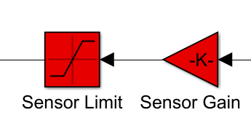
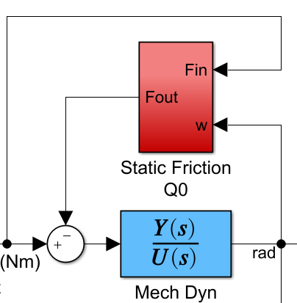
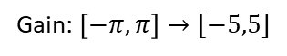





Sensor
Static Friction
Sensor Feedback
The sensor maps the actual angle of the motors to voltage linearly.
Static friction works against the applied force and turns into dynamic friction after motor starts moving. It is given by:
$$F_{static}=μF_{N}$$
$$F_{static}=μg(Mass_{\text{link}}+{Mass}_{motor}+{Mass}_{counter})$$
voltage
angle
Implementation
If the applied torque < torque due to static friction, then net torque = 0
-5V
+5V
$$−π$$
$$π$$
Gain: $\left[−π,π\right]→[−5,5]$
Since the mass of the rotor is negligible, motor $q_{1}$does not experience any static friction

Slide 9


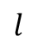


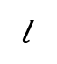
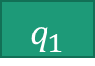

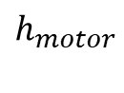


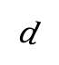



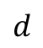
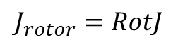


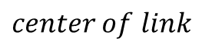

Mechanical Motor Dynamics
$$J_{counter weight}$$
$$J_{motor weight}$$
$$l$$
$$h_{Link}$$
$$q_{1}$$
$$J_{rotor}$$
$$d$$
$$h_{motor}$$
$$l$$
$$d$$
$$J_{rotor}=RotJ$$
$$J_{rotor}$$
$$q_{1}$$
$$center of link$$
$$J_{link}$$
$J_{q1 weight}=J_{counter weight}=\frac{1}{3}\frac{{Mass}_{motor}}{h_{motor}}$(${{(h}_{motor}\text{+}l)}^{3}−l^{3}$)
$$q_{0}$$
$J_{q0}=$ $J_{link}+J_{rotor}+J_{q1 weight}+J_{counter weight}$
$J_{q1}=$ $J_{rotor}$

Slide 10

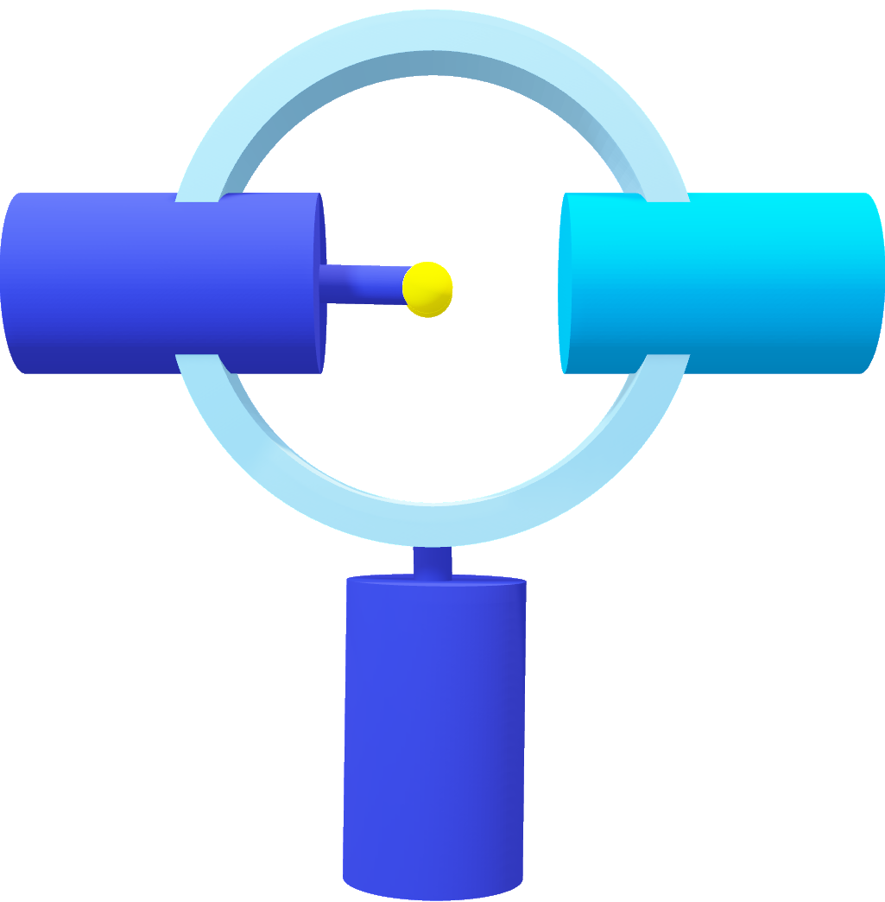




Electric Motor Dynamics
The DC motor has relationships between the torque and the current
$$τ=K_{τ}i$$
The current is given by Ohm’s law
$$i=\frac{V_{in}−V_{emf}}{Ls+R}$$
Motor 1
The back-EMF is proportional to the motor speed
$$V_{emf}=K_{b}ω$$
The two motors for $q_{0} and q_{1}$ are identical, so the relationships are the same for both motors
Motor 0

Slide 11
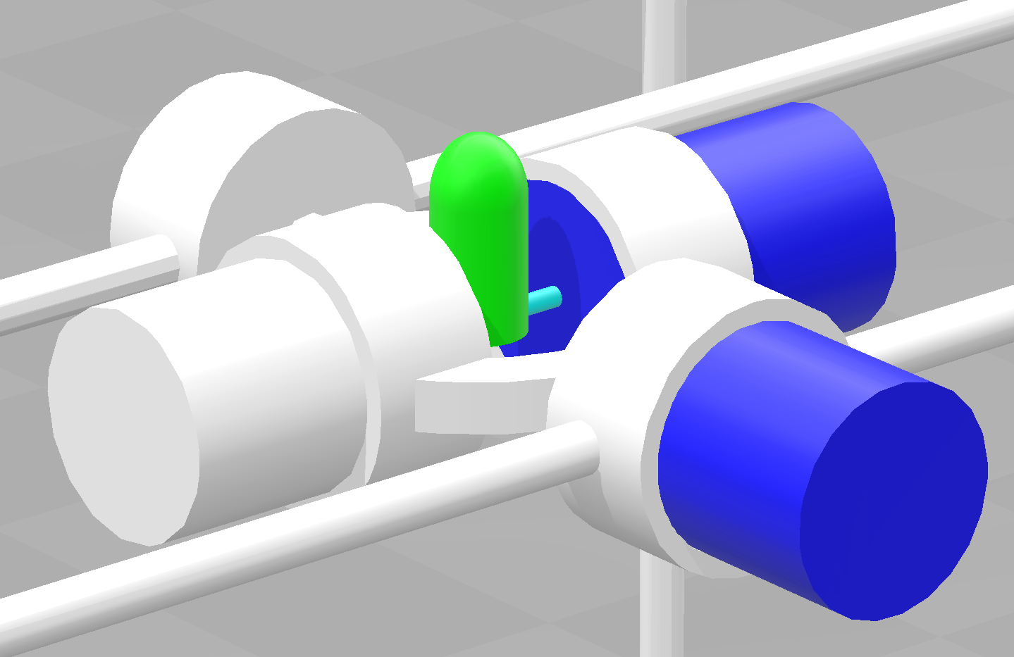


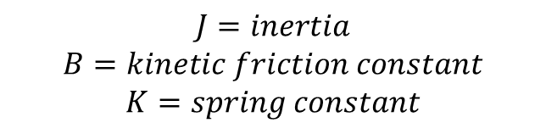
Mechanical Motor Dynamics
$$τ=ω(Js+B+\frac{1}{S}K)$$
$$J=inertia$$
$$B=kinetic friction constant$$
$$K=spring constant$$

